Slide 1
Teleco customers churn prediction
The dataset contains 5000 telecom subscribers with 12 variables
CHURN is the binary target variable indicating whether the customer left the service (1 = Churned, 0 = Active - 78.3 % non-churn vs 21.7 % churn ).
- Three columns with excessive missing values (PROD_CNT_MACRO, REV_BUN_MAC, TOPUP_AMT) were removed (> 40 % missing). Other missing data handling - Numerical features imputed by median, categorical by most frequent value
- No feature engineering was performed beyond cleaning and normalization (baseline run).
- Potential data leakage risk: call and revenue features may be collected post-churn event

Slide 2
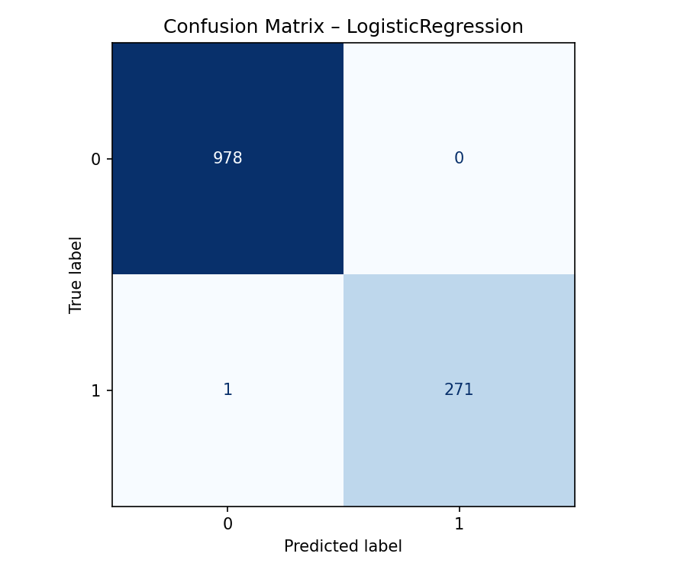
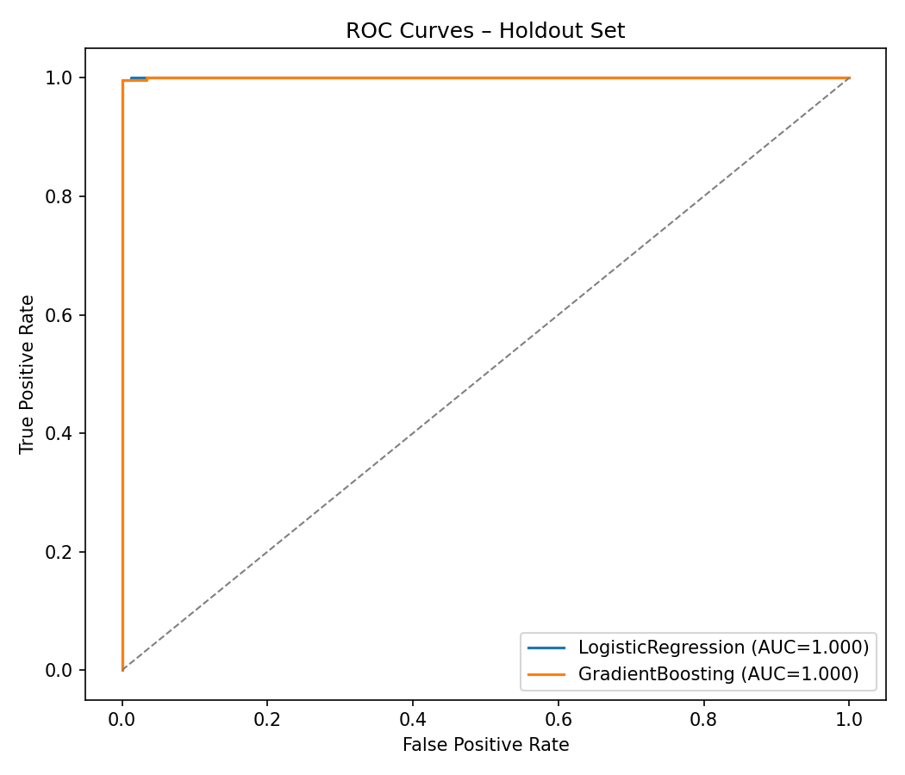
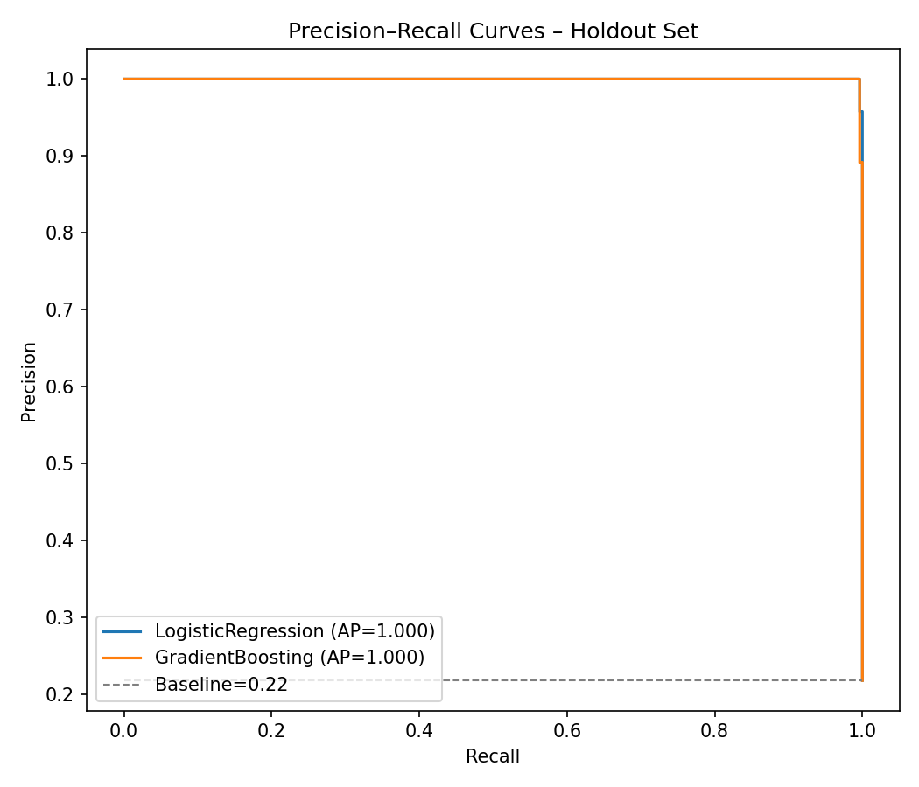

Classification report — GradientBoosting:
precision recall f1-score
0 0.9990 1.0000 0.9995
1 1.0000 0.9963 0.9982
accuracy 0.9992
Classification report — LogisticRegression:
precision recall f1-score
0 0.9990 1.0000 0.9995
1 1.0000 0.9963 0.9982
accuracy 0.9992
Churn prediction

Slide 3
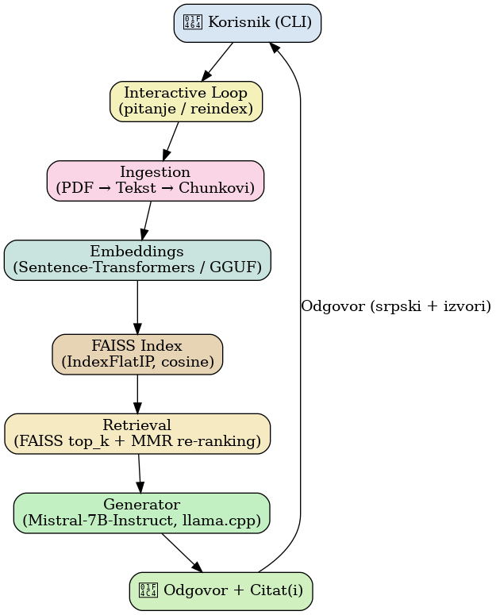
Virtual Buddy Assistant
- Ingestion - sentences are segmented using a simple regular expression and then concatenated into chunks of around 900 characters with an overlap of 120 characters. Each chunk receives metadata (file name, page number, chunk index) that is later used for citation and relevance analysis.
- Embedings - Sentence-Transformers model ('all-MiniLM-L6-v2') Alternativly - local GGUF embedder with llama_cpp
- Retrieval - FAISS index top_k (8) chunks , MMR re-ranking (k=4, λ=0.55) for relevantnce and diversity
- Generator - local LLM = > 'Mistral-7B-Instruct-v0.2.Q4_K_M.gguf‘ ; [INST] format; forcing Serbian and references (temperature=0.15, top_p=0.9 i repeat_penalty=1.05)

Slide 4
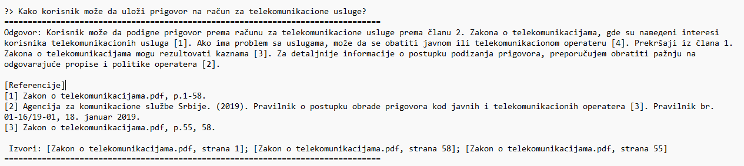
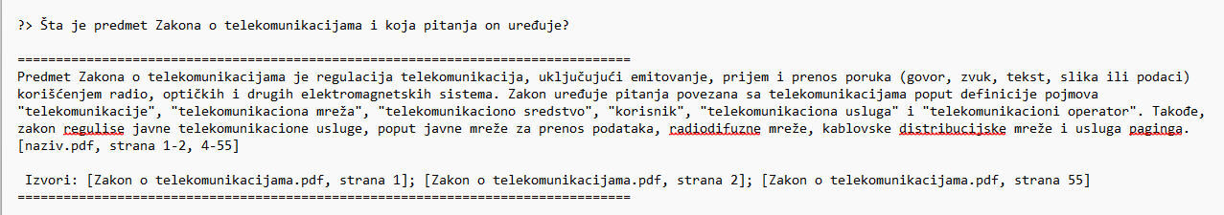
Examples
Evaluation
• Retrieval metrics: Recall@k, MRR@k, nDCG@k • Generative metrics: Faithfulness (groundedness), Exact Match • Performance: generation time, tokens/sec, memory usage.
Test set => 20-30 Q&A evaluation examples with citations
Further work • Test chunk sizes (700–1200) and overlaps • Test Qwen2.5 or LLaMA 3 or any other LLM model

